Slide 1
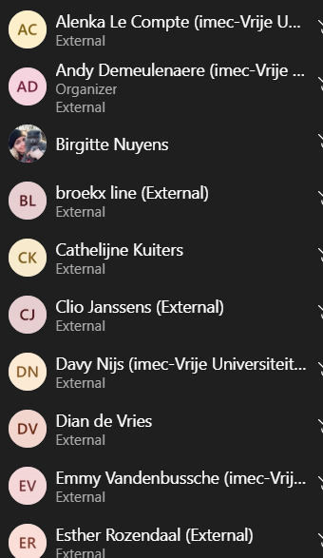
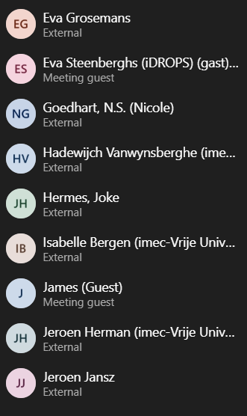
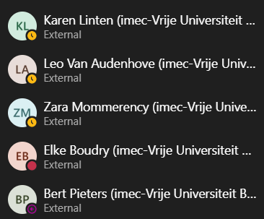
Notes:
New examples

Slide 2
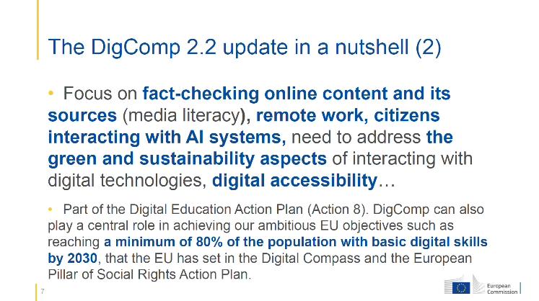

Slide 3
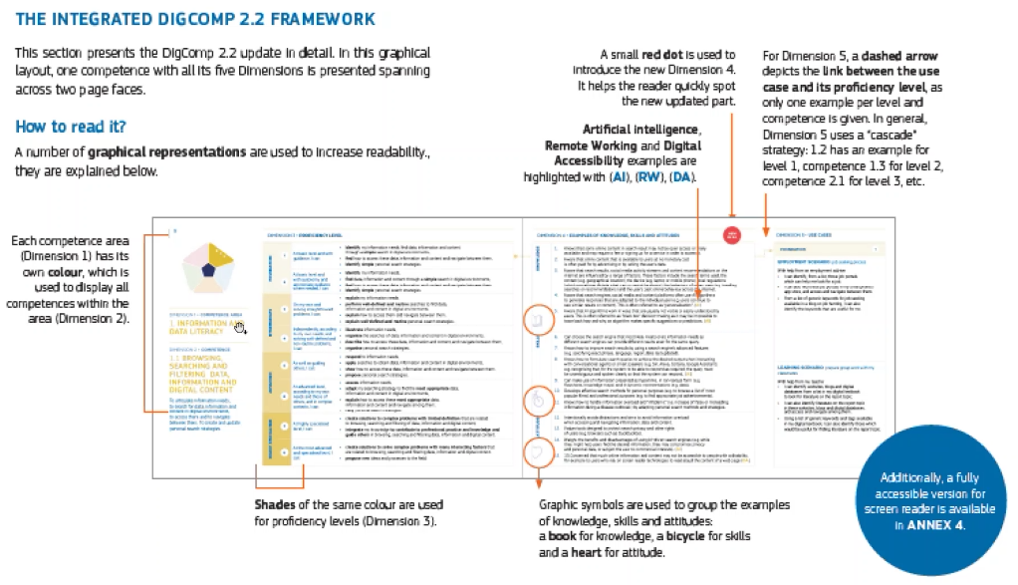
Notes:
New: examples of knowledge, skills and attitudes

Slide 4
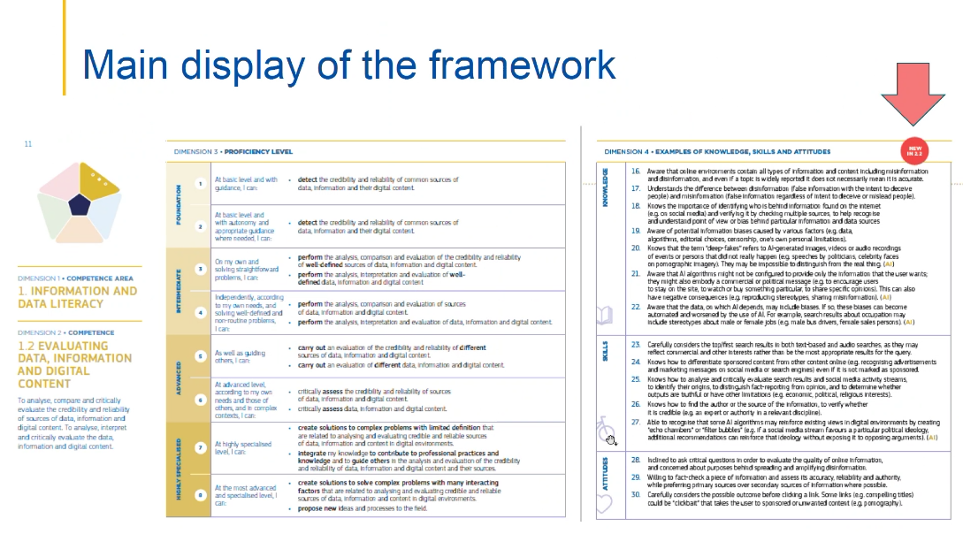

Slide 5
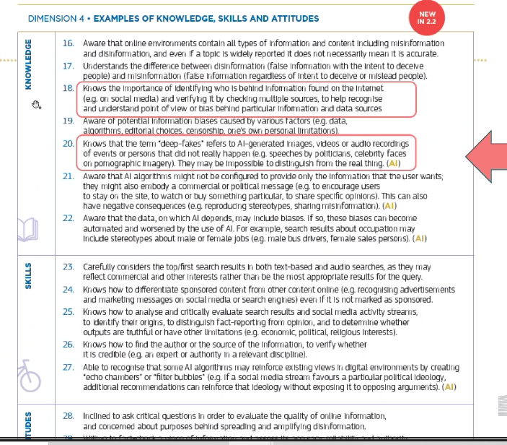

Slide 6
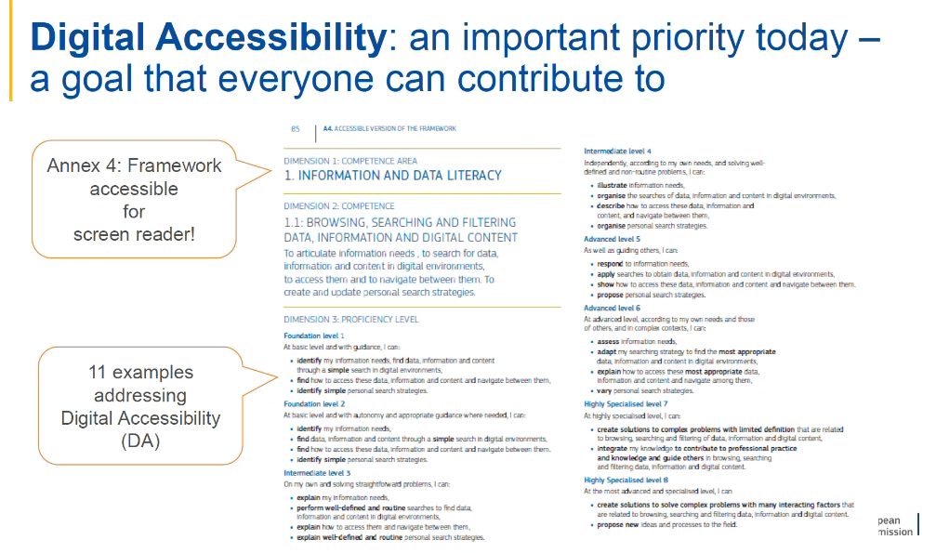
Notes:
New look and feel
Accessible online

Slide 7
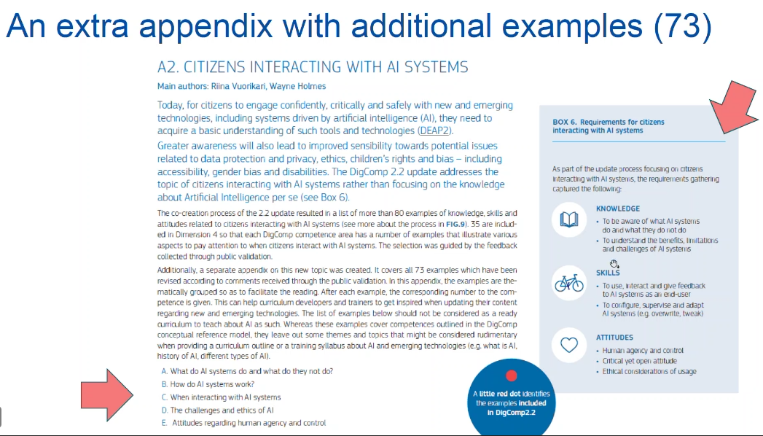

Slide 8
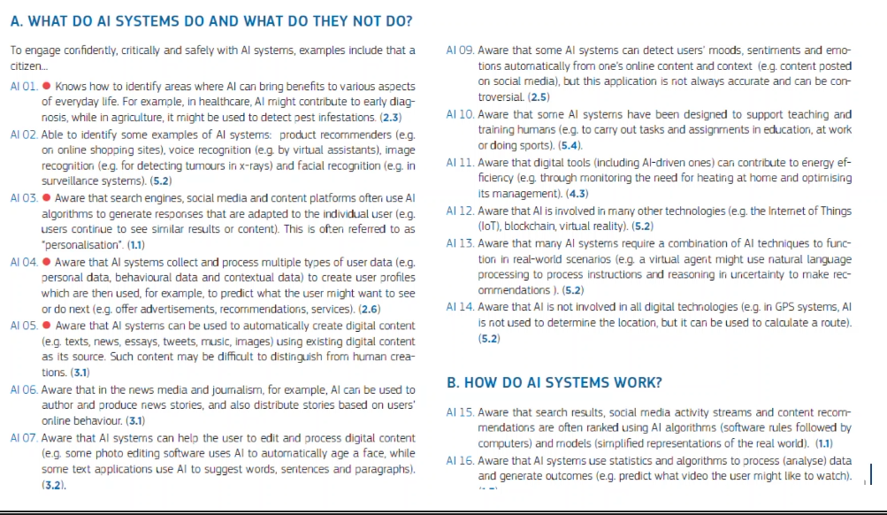

Slide 9
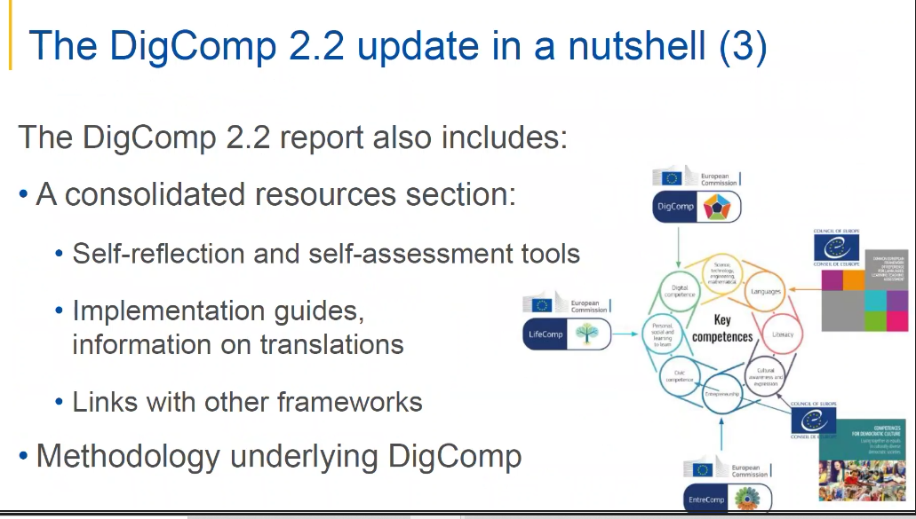

Slide 10
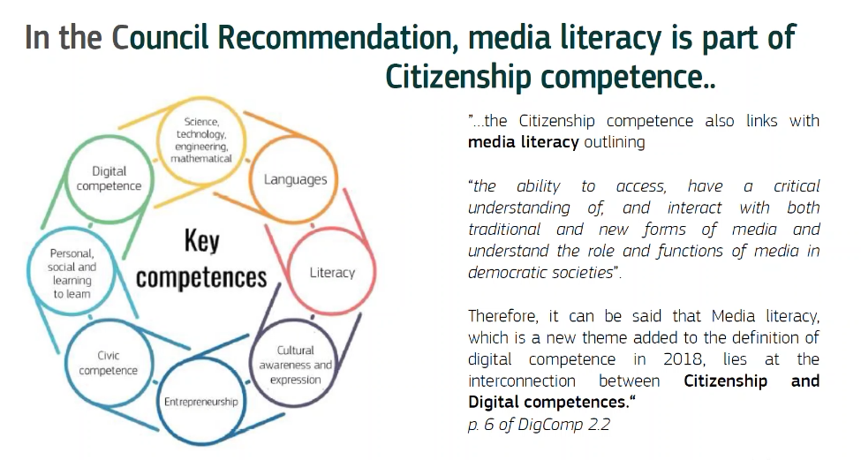

Slide 11
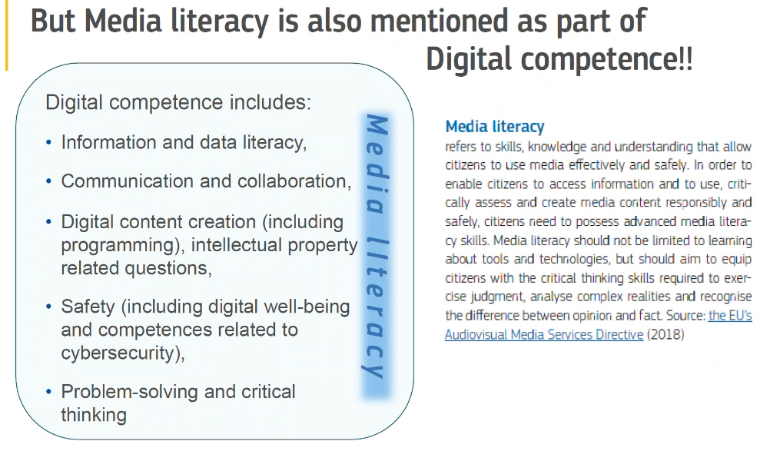

Slide 12
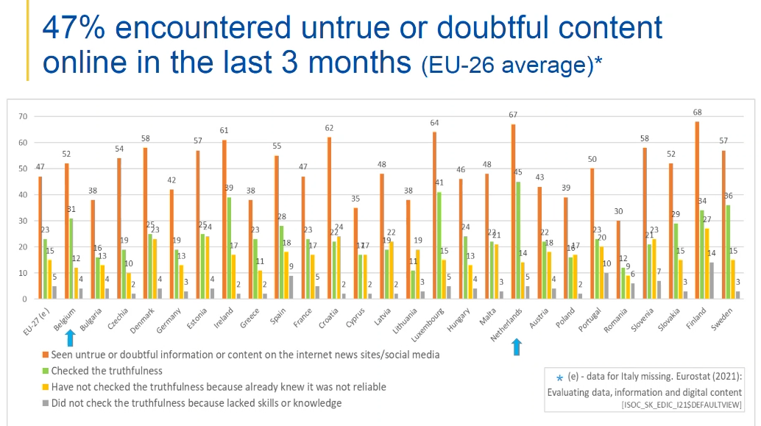

Slide 13
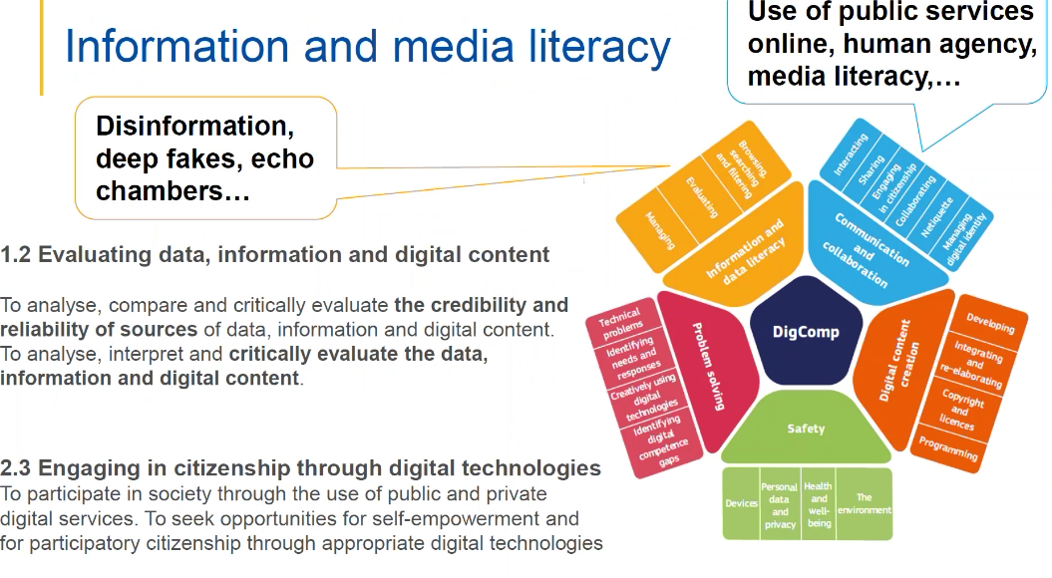

Slide 14
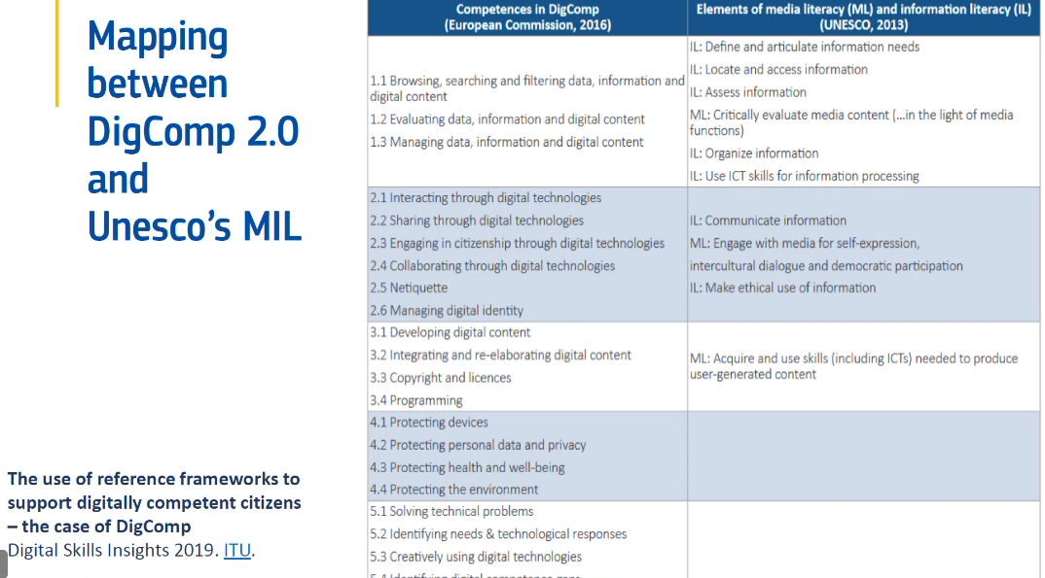

Slide 15
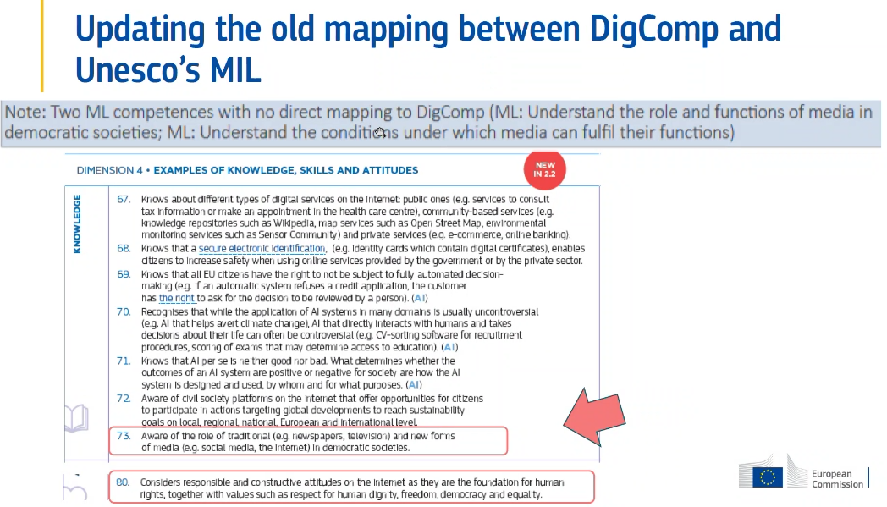

Slide 16
[14:40] Dian de Vries
`For who may be interested in a measure: we have developed and validated a digital skills and a digital knowledge measure based on the DigComp framework. It also includes AI, Green/Sustainability, Health and Wellbeing, Fake news, etc. All the competences of DigComp 2.2. It is validated (CFA, MI, Rasch, reliability) or age 16-plus and in the next months we will collect more data to see if it works also for age 10-16. It is still under development, but you can find the items here: https://osf.io/w8brs/ (or contact me for more info)
heart 1 like 1
DigIQ
Hosted on the Open Science Framework
[14:37] Andy Demeulenaere (imec-Vrije Universiteit Brussel)
The EU uses Knowledge, Skills and Attitudes as elements of a competence, the Council of Europe uses Knowledge and critical understanding, Skills, Attitudes and Values as elements of a competence. What are your thoughts on that? Do you know of any intentions to align those two?
like 1

Slide 17
Leo van Audenhove

Slide 18
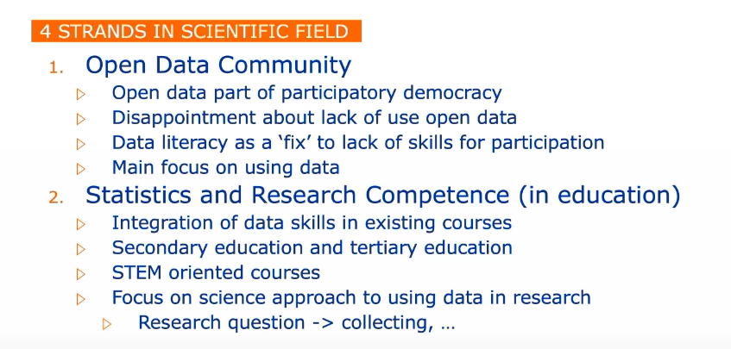

Slide 19
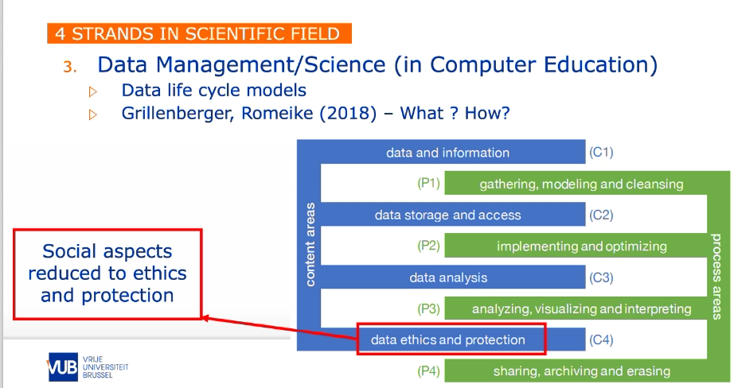

Slide 20
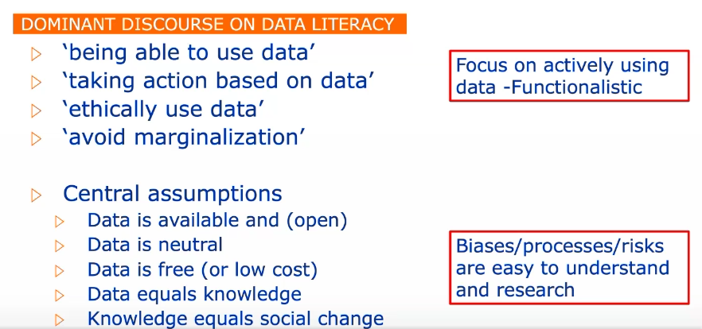

Slide 21
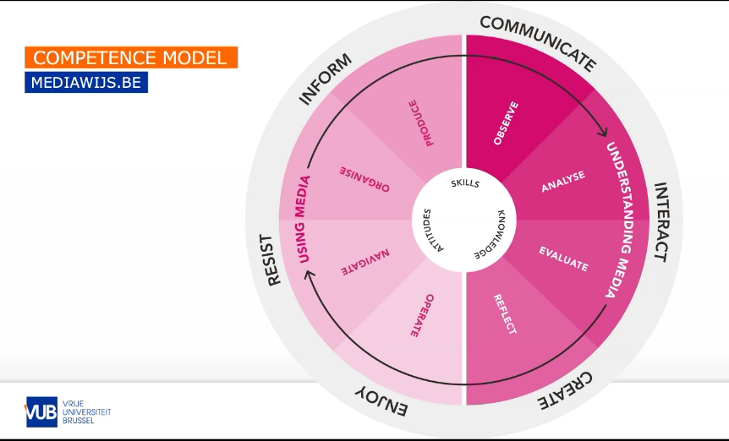

Slide 22
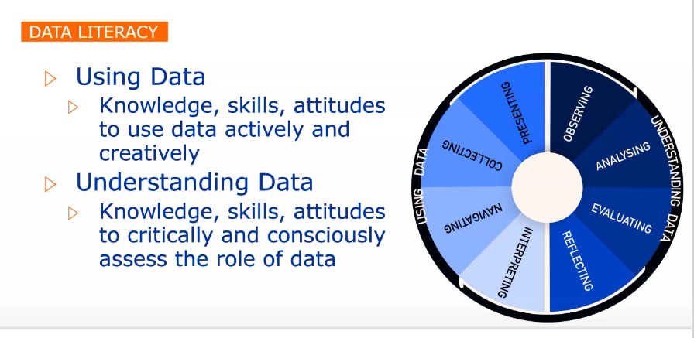

Slide 23
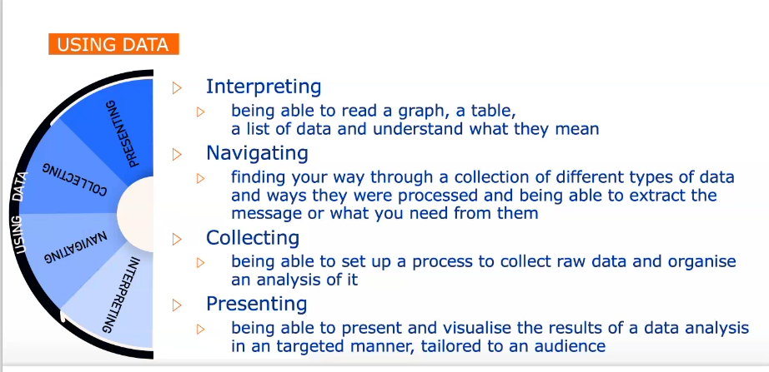

Slide 24
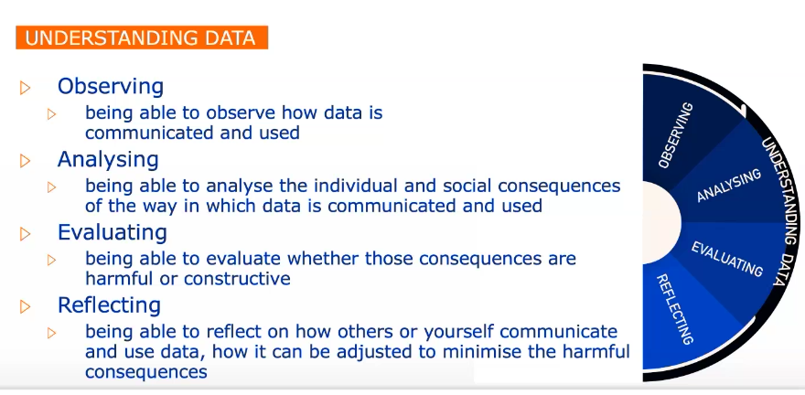

Slide 25
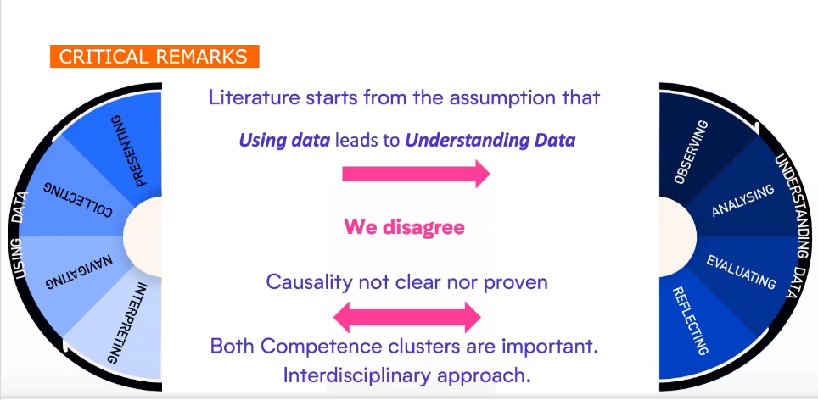

Slide 26
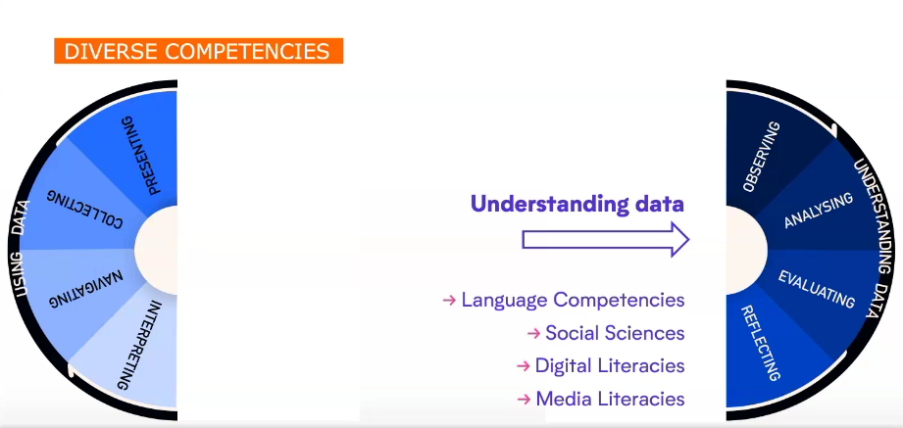

Slide 27
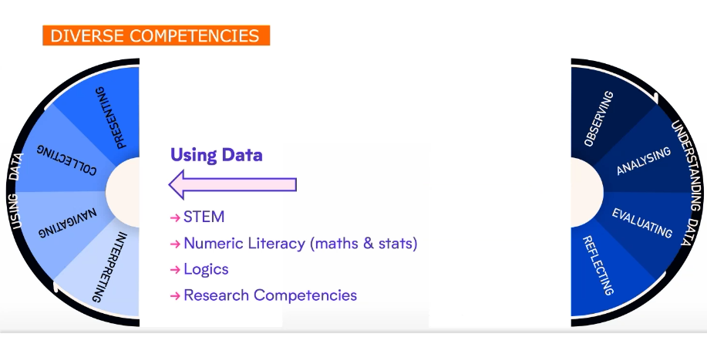

Slide 28
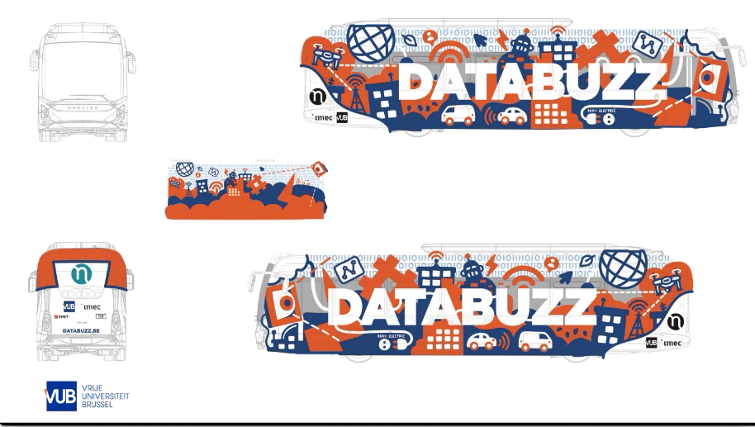

Slide 29
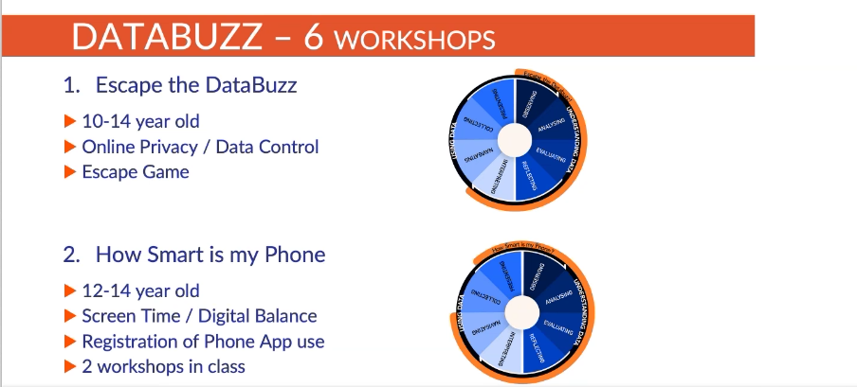

Slide 30
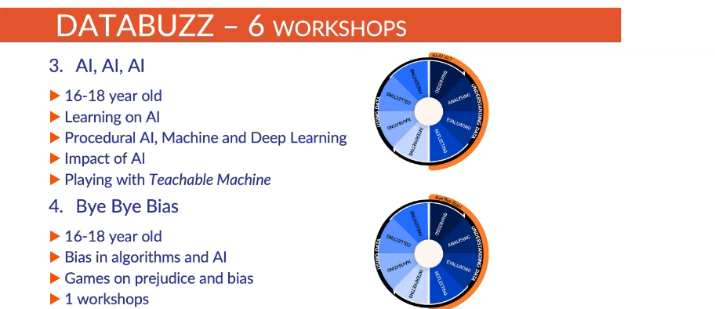

Slide 31
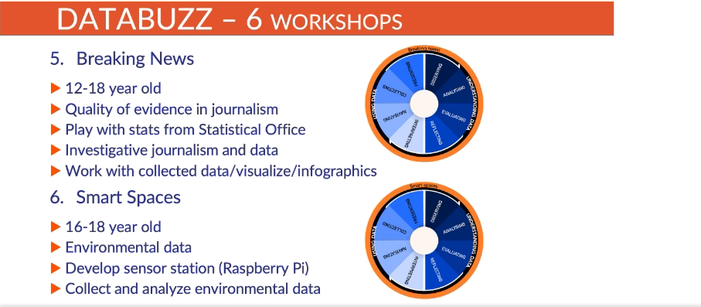

Slide 32
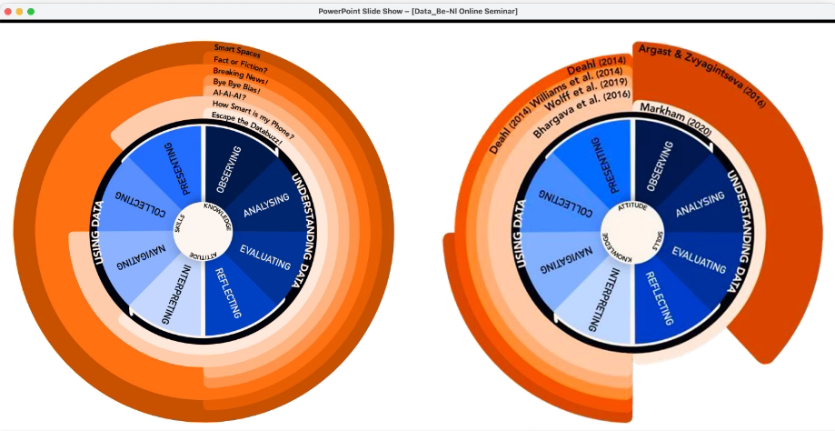

Slide 33
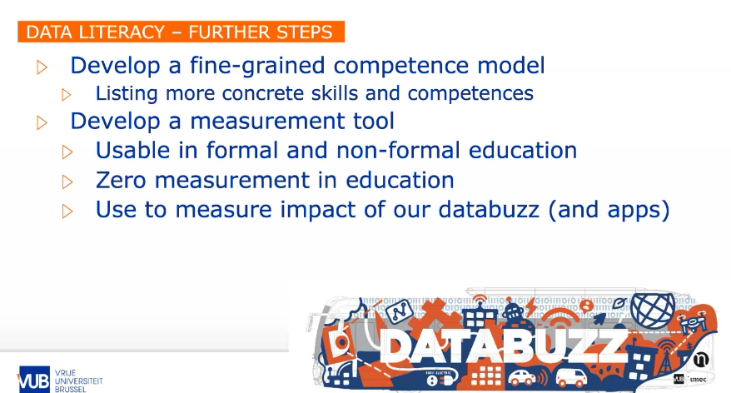

Slide 34
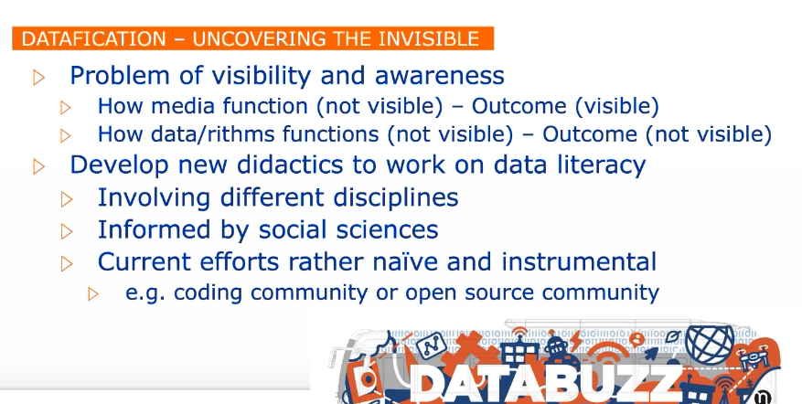

Slide 36
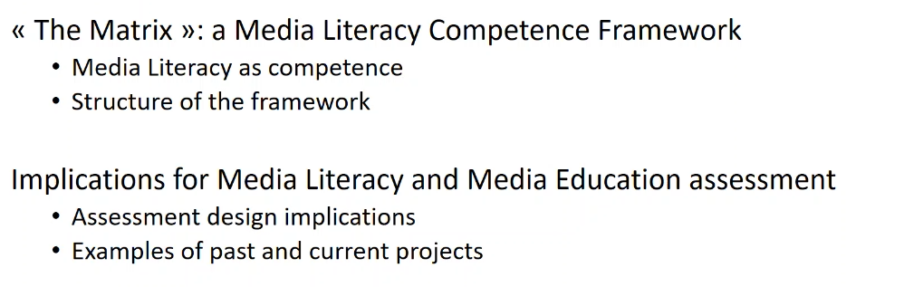

Slide 37
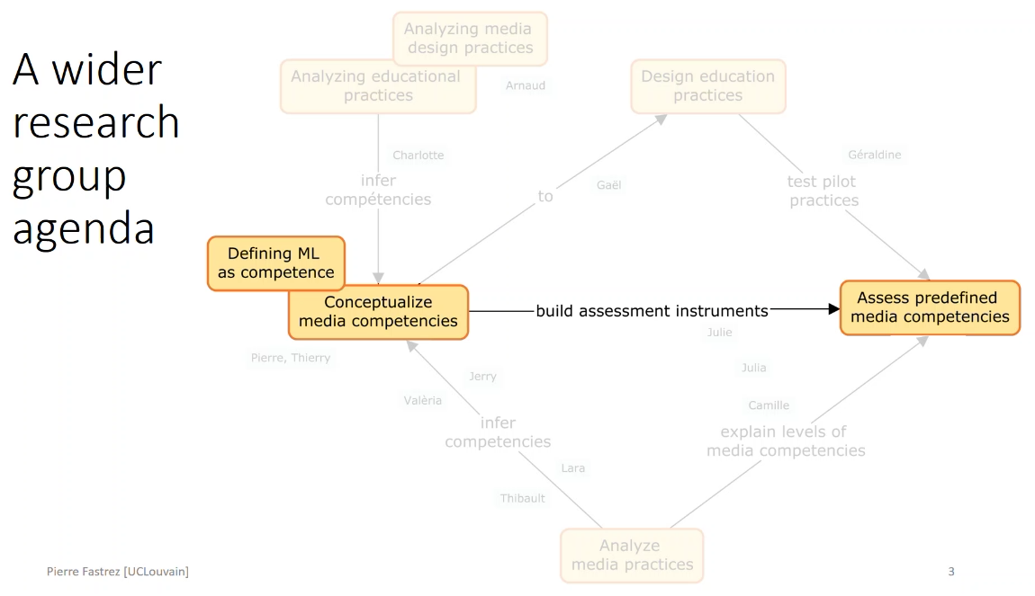

Slide 38
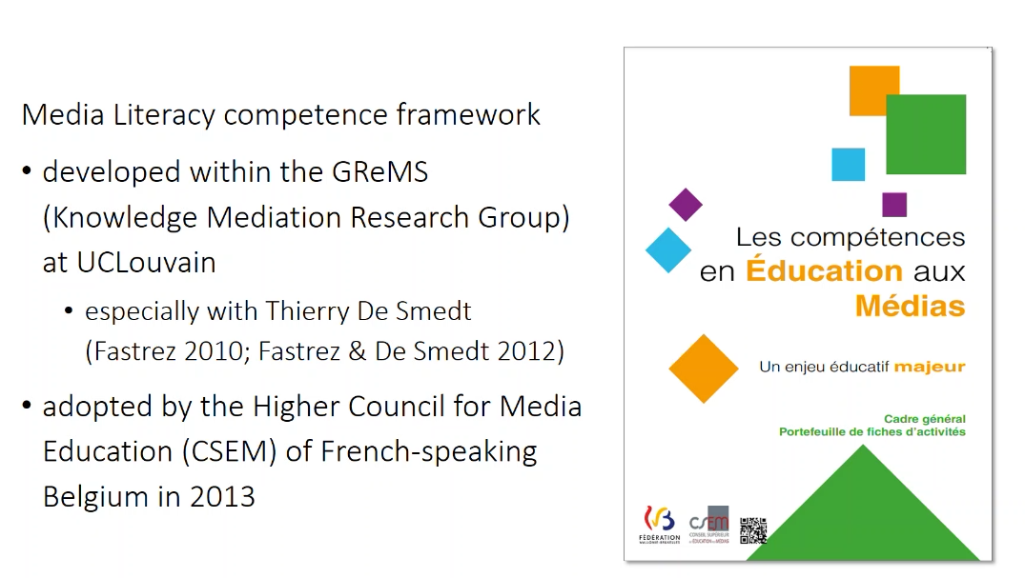

Slide 39
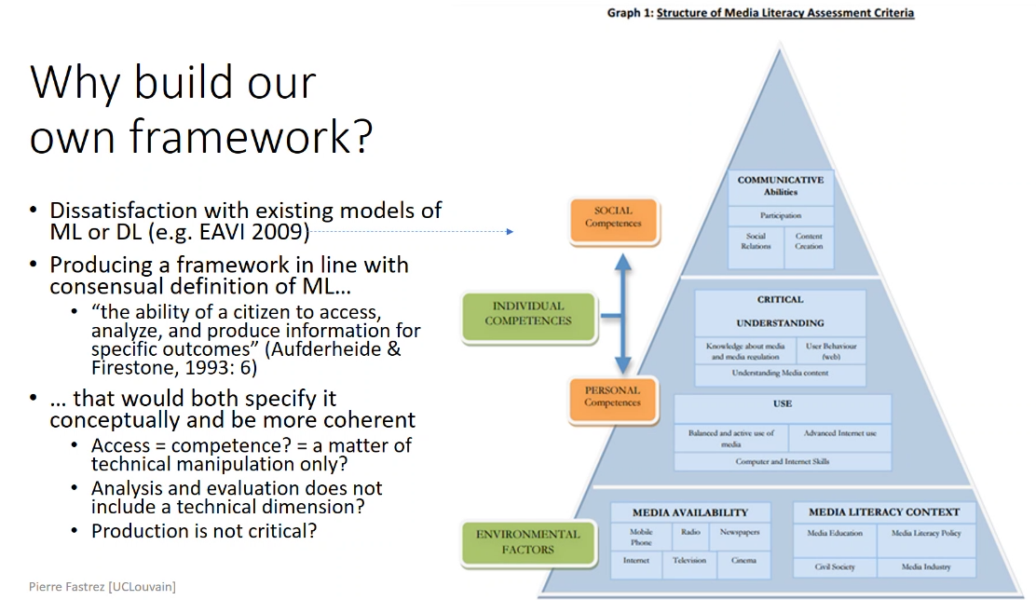

Slide 40
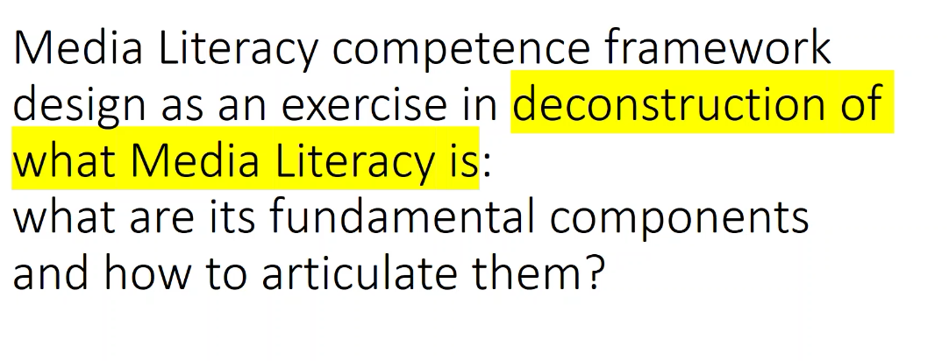

Slide 41
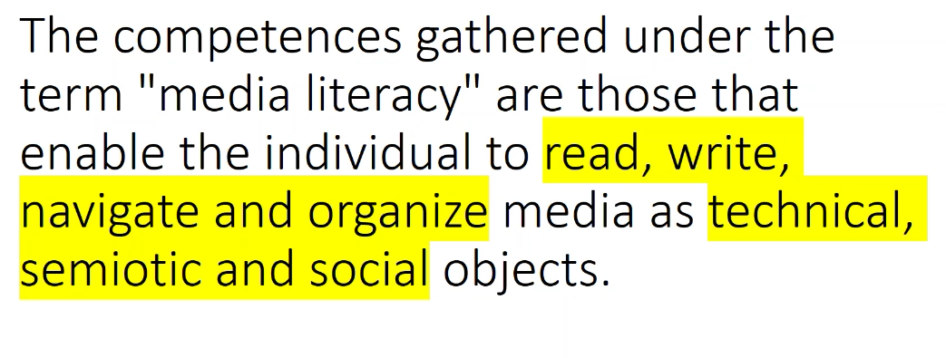

Slide 42
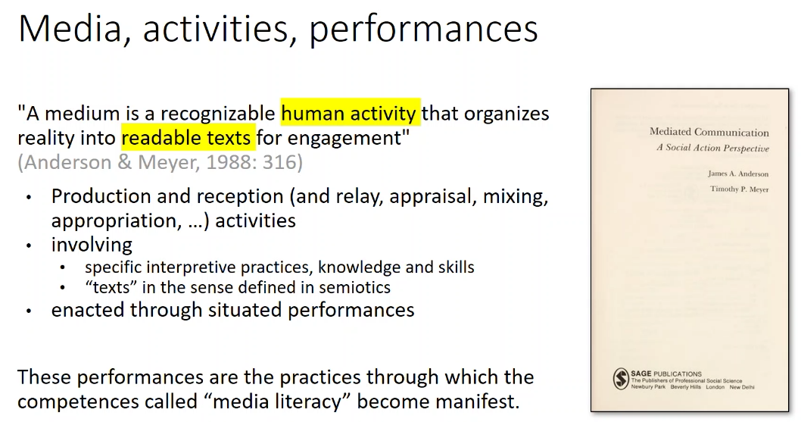

Slide 43
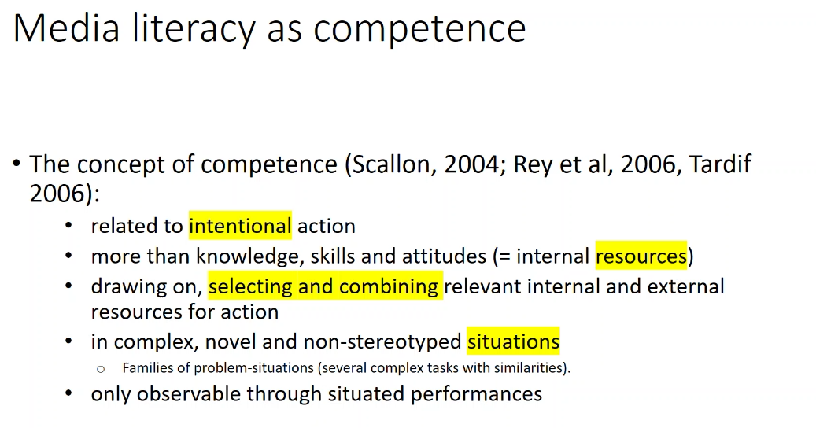

Slide 44
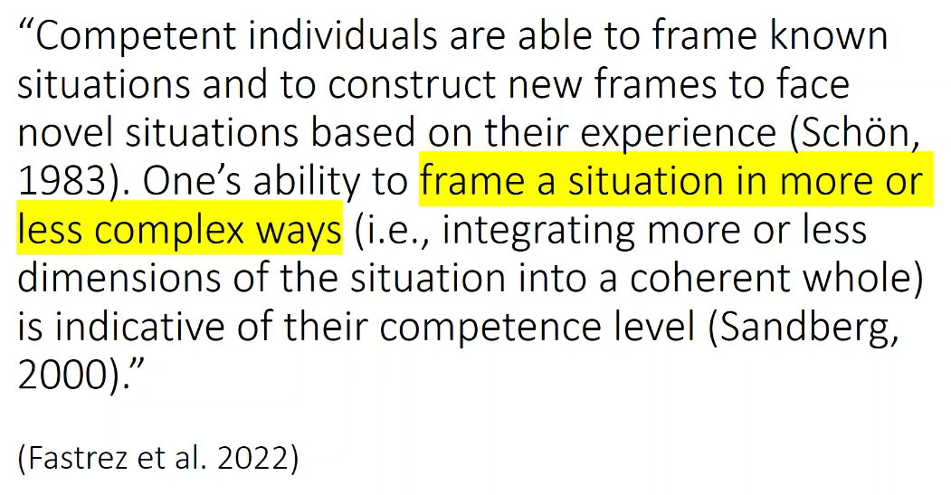

Slide 45
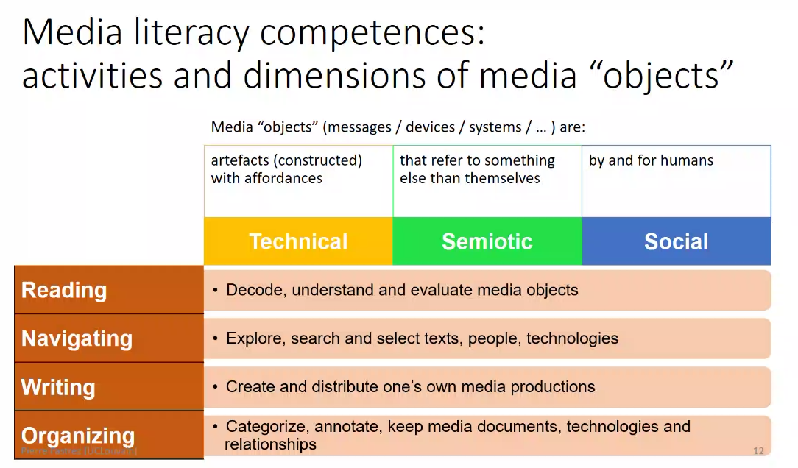

Slide 46
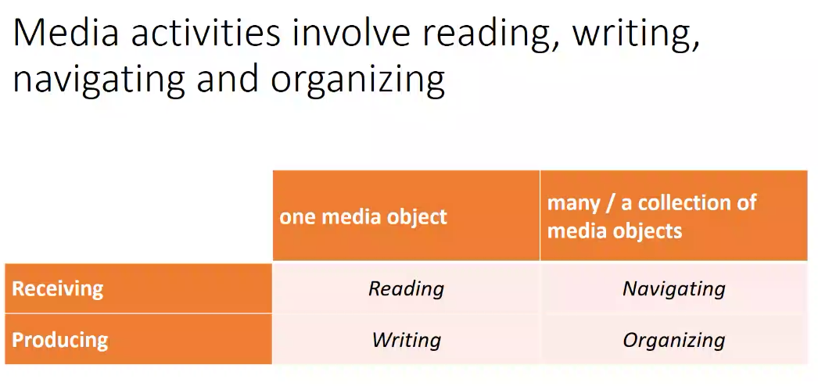

Slide 47
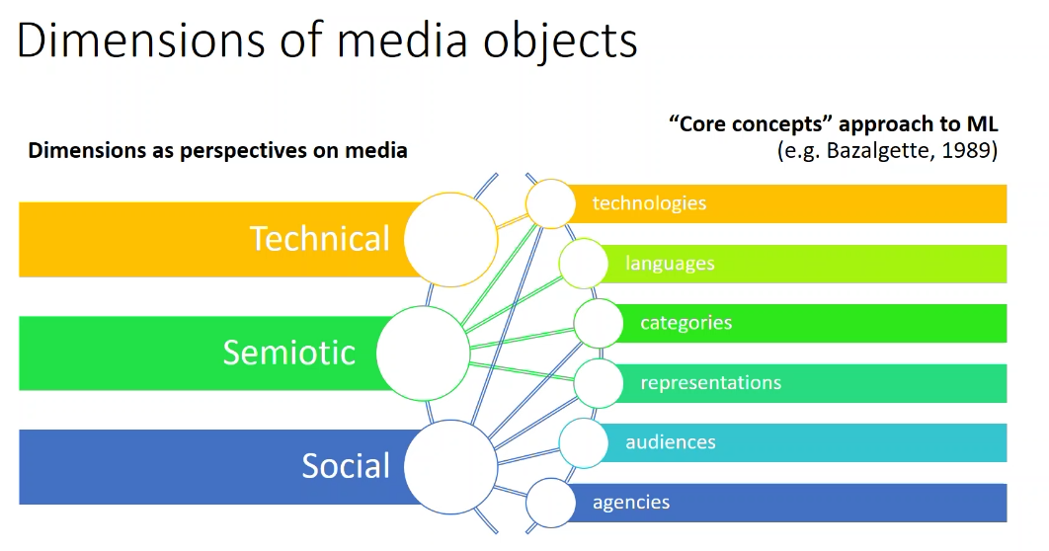

Slide 48
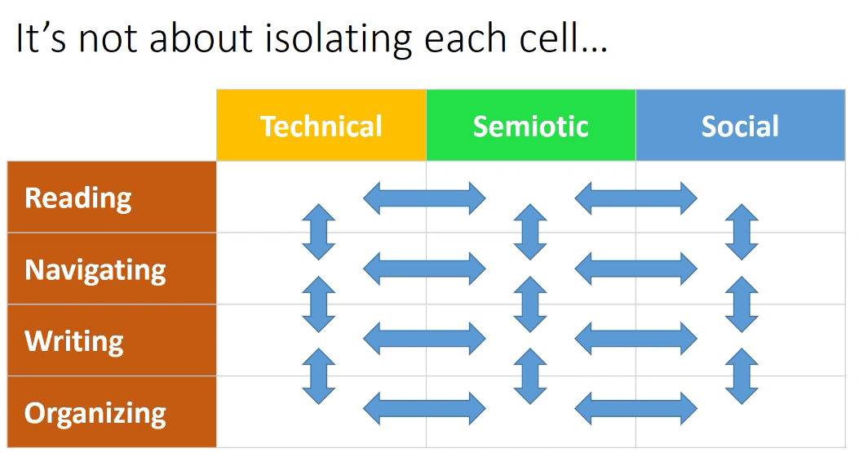

Slide 49
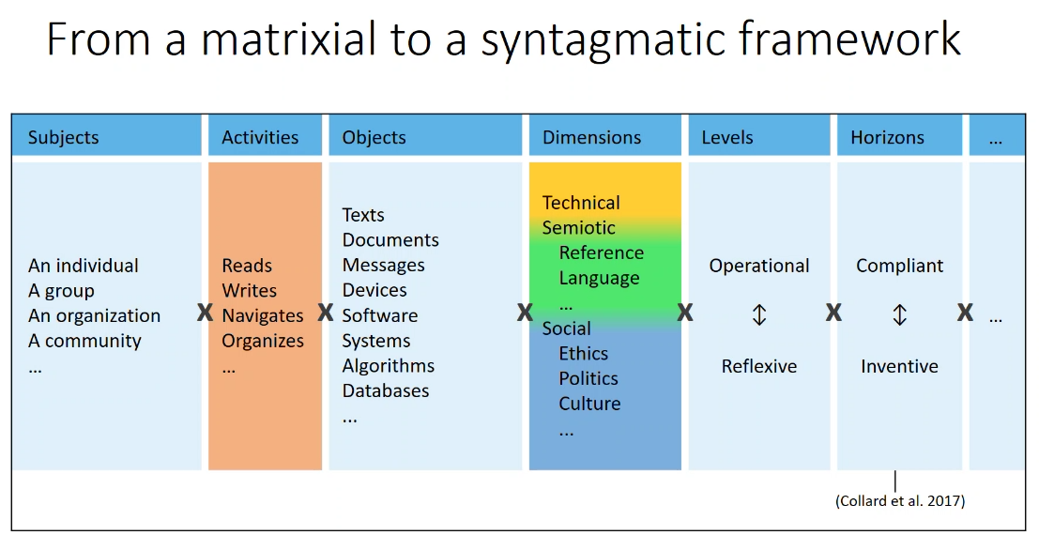

Slide 50
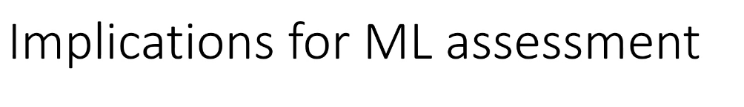
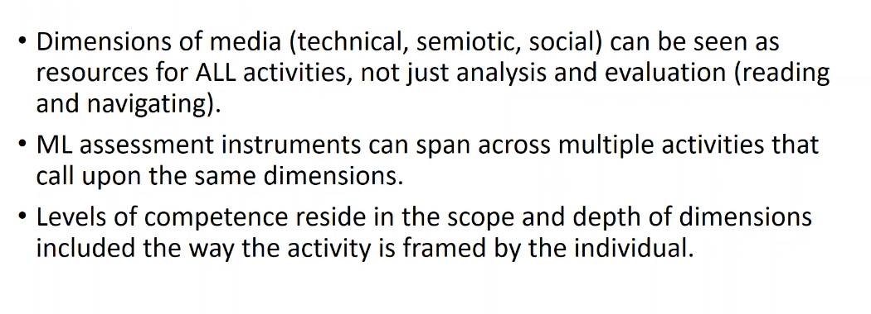

Slide 51


Slide 52


Slide 53


Slide 54


Slide 55


Slide 56


Slide 57
Notes:
xxx

Slide 58


Slide 59


Slide 60


Slide 62

Notes:
https://digcomp.digital-competence.eu/

Slide 63

Notes:
https://mydigiskills.eu/

Slide 64

Notes:
https://www.statbeljunior.be/fr

Slide 65

Notes:
https://publications.jrc.ec.europa.eu/repository/handle/JRC123226

Slide 66

Notes:
https://teachablemachine.withgoogle.com/

